Slide 1
Capstone Project Battle of the Neighborhoods
Opening a Japanese Restaurant in New York City
By: Shigeharu Kaneko

Slide 2
Introduction: Business Problem Opening a Japanese Restaurant
New York City's demographics show that it is a large and ethnically diverse metropolis. With it's diverse culture , comes diverse food items. There are many restaurants in New York City, each belonging to different categories like Chinese , Spanish , French etc.
If you're a stakeholder, entrepreneur, or chef interested in opening a Japanese restaurant in New York city, this will be for you.
Using efficient data science tools, we will suggest the promising locations to solve the below problems of finding out
Which areas in New York City have Japanese restaurants?
Which all areas lack Japanese Restaurants?
Which is the best location for Japanese restaurants in New York City?

Slide 3
Data Source
For this project we need the following data:
(1) New York City data that contains list Boroughs, Neighborhoods along with their latitude and longitude.
Data source : https://cocl.us/new_york_dataset
Description : This data set contains the required information. And we will use this data set to explore various neighborhoods of New York City.
(2) Japanese restaurants in each neighborhood of New York City.
Data source : Fousquare API
Description : By using this API, we will get all the venues in each neighborhood. We can filter these venues to get only Japanese restaurants.
(3) GeoSpace data
Data source : https://data.cityofnewyork.us/City-Government/Borough-Boundaries/tqmj-j8zm
Description : By using this geo space data we will get the New York Borough boundaries that will help us visualize choropleth map.

Slide 4
Methodology
(1) Collect the New York City data from https://cocl.us/new_york_dataset.
(2) Find all venues for each neighbourhood using FourSquare API.
(3) Filter out all venues that are Japanese Restaurants.
(4) Find rating, tips and like count for each Japanese Restaurants using FourSquare API.
(5) Sort the data using rating for each restaurant.
(6) Visualize the Ranking of neighborhoods using python's Folium library.

Slide 5

Results & Discussion
There are total of 306 different Neighbourhoods in New York
We have 208 Japanese Restaurants across New York City
Stuyvesant has the highest average rating = 9.2 for Japanese Restaurants among all neighborhoods

Slide 6
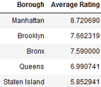
Results & Discussion
Top 3 Boroughs with top average ranking of Japanese Restaurants are: Manhattan (8.72), Brooklyn (7.66) and Bronx (7.59)
The recommendation location to open Japanese Restaurant is Stuyvesant Town based on the best-rated Japanese Restaurant in New York.

Slide 7
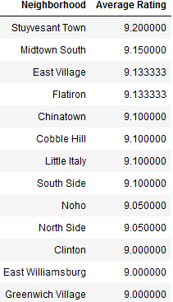
Conclusion
According to the above results and discussion, these are all neighborhoods option to open the first Japanese Restaurant.

